Slide 1







My Two sided Marketplaces app
Game cabin

Slide 2

What is the problem?
1
Background
Gaming market grows fast
2
Players don’t want to keep lots of game and gear
3
Players want bargain game and gear
4

Slide 3
Solution within my app
Players can sell the game or gear that they don’t need
1
2
Players can buy the used game items from other player with lower price.
After players re-use the used game, they can sell it in the app again to achieve more financial sustainability。
3

Slide 4

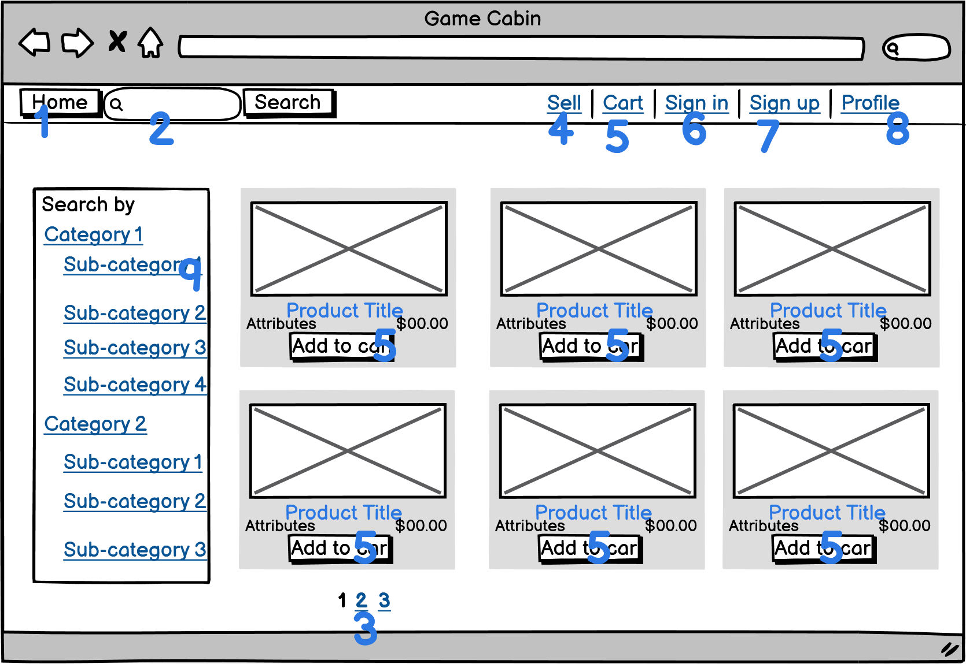
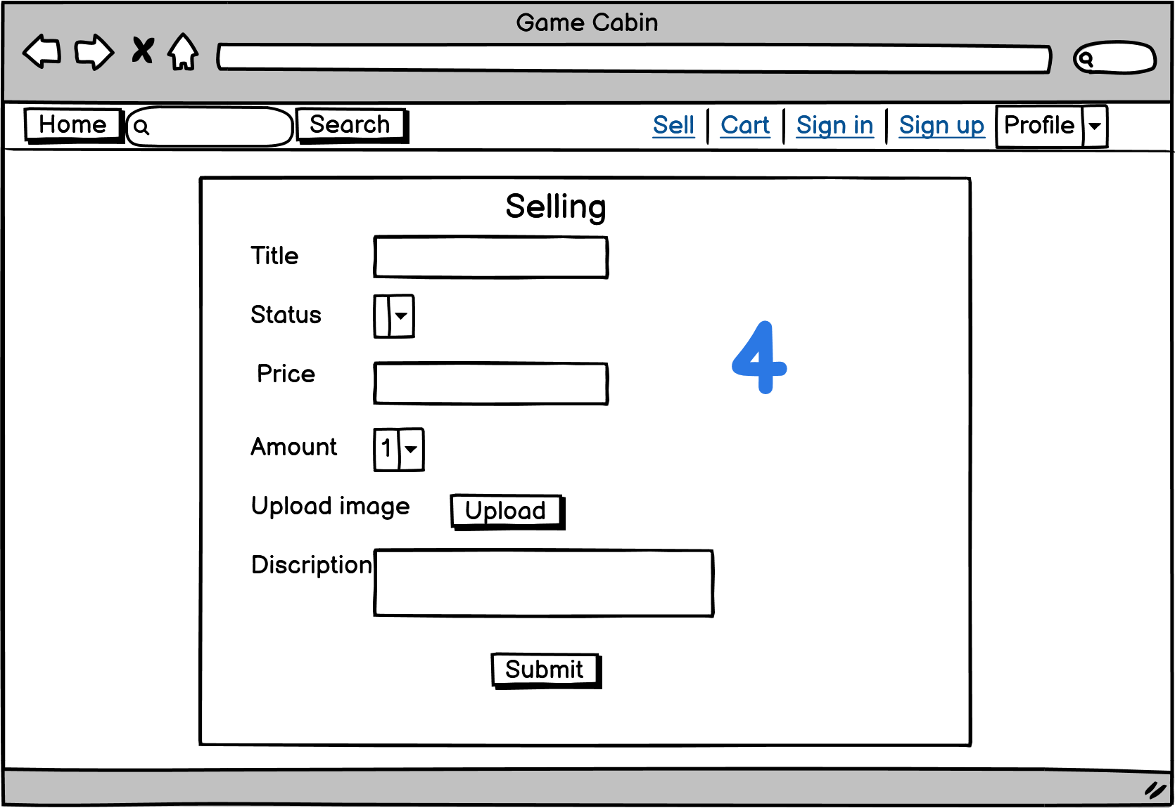
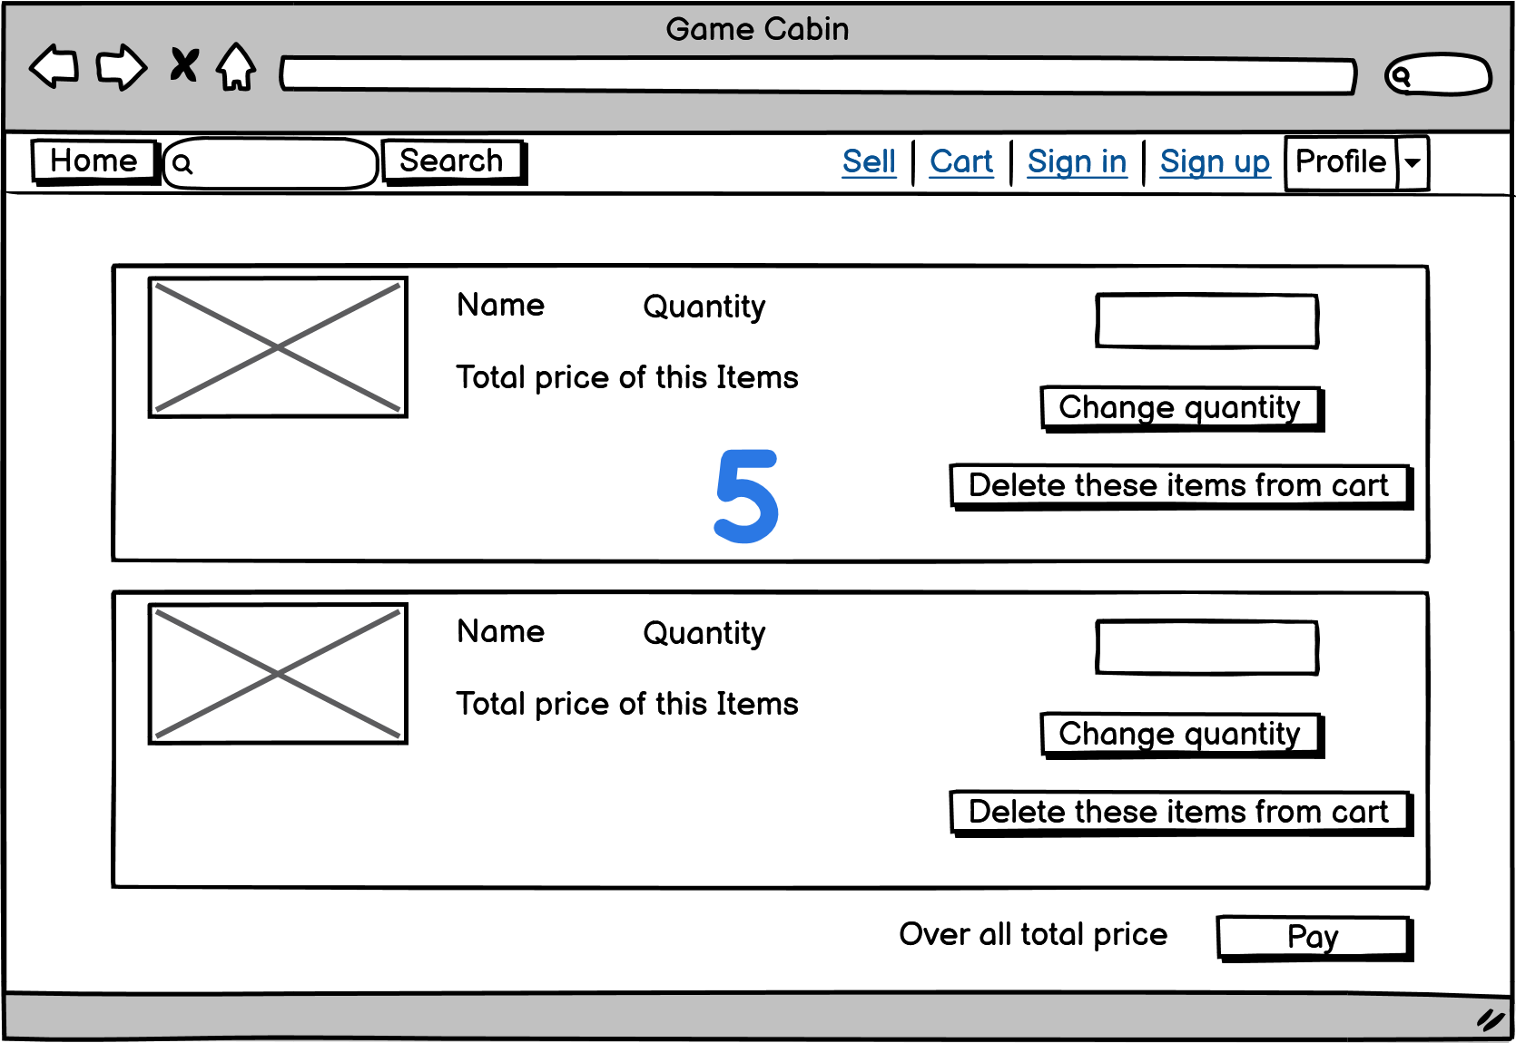
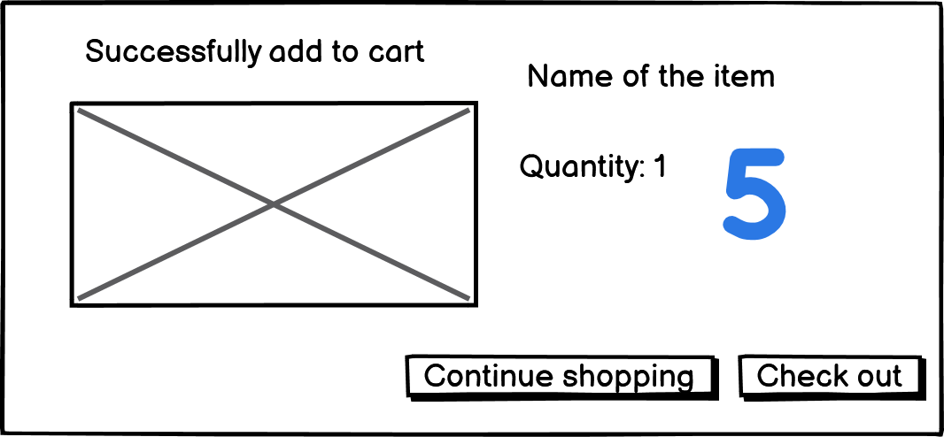

Slide 5
